Slide 1
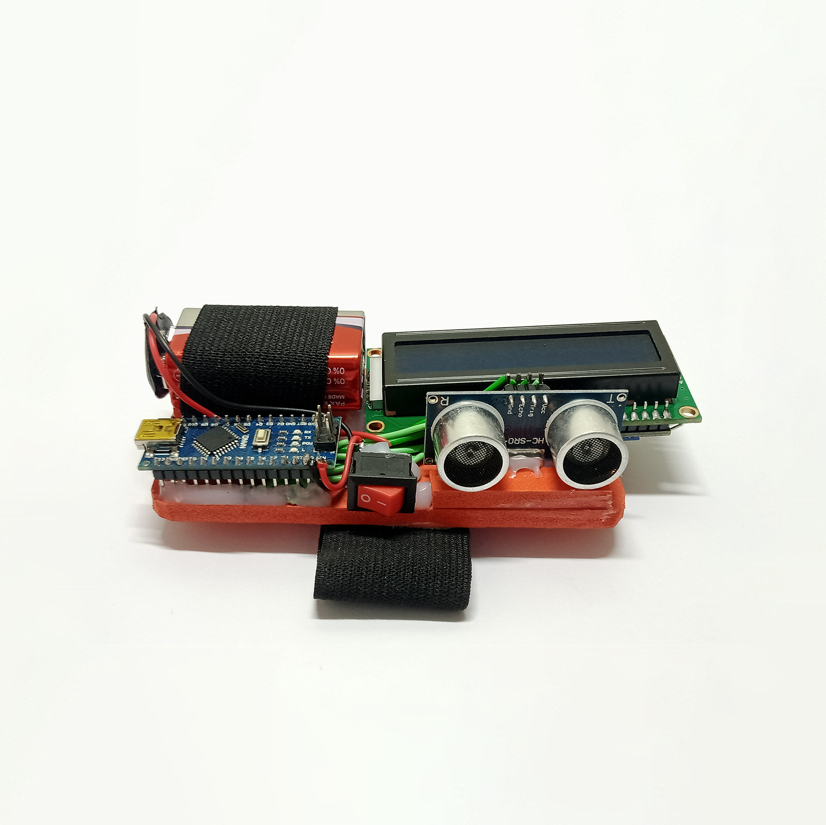
Portable Ultrasonic Range Meter for Non-Contact Distance Measurement
Presented by Team Prefetch

Slide 2



TANVIR AHAMMAD
Supervisor
Lecturer, Dept. of CSE, JnU
NISHAT MAHMUD
MD. WALIUL ISLAM RAYHAN
B190305003
B190305034
Computer Peripherals and Interfacing Lab
CSEL-3208

Slide 3
Problem Statement
In many situations, traditional measurement tools like tape or scales may not be practical or possible to use.
Existing measurement systems often suffer from low accuracy levels.
Cost-effectiveness is a concern with many current solutions.
Most existing methods require physical contact.

Slide 4
Objectives
Obtain accurate distance measurements ranging from 2cm to 400cm with customized floating-point precision.
Design a compact and portable device suitable for wearing on the hand.
Ensure minimal power consumption for extended battery life.
Utilize the Arduino platform to streamline development and enhance adaptability.

Slide 5
Main Features
Non-contact distance measurement using ultrasonic technology
Accurate measurements (2cm to 400cm with floating points)
Real-time display on a 16x2 LCD screen
Compact, portable and wearable design
Low power consumption
Continuous measurement without delays

Slide 6
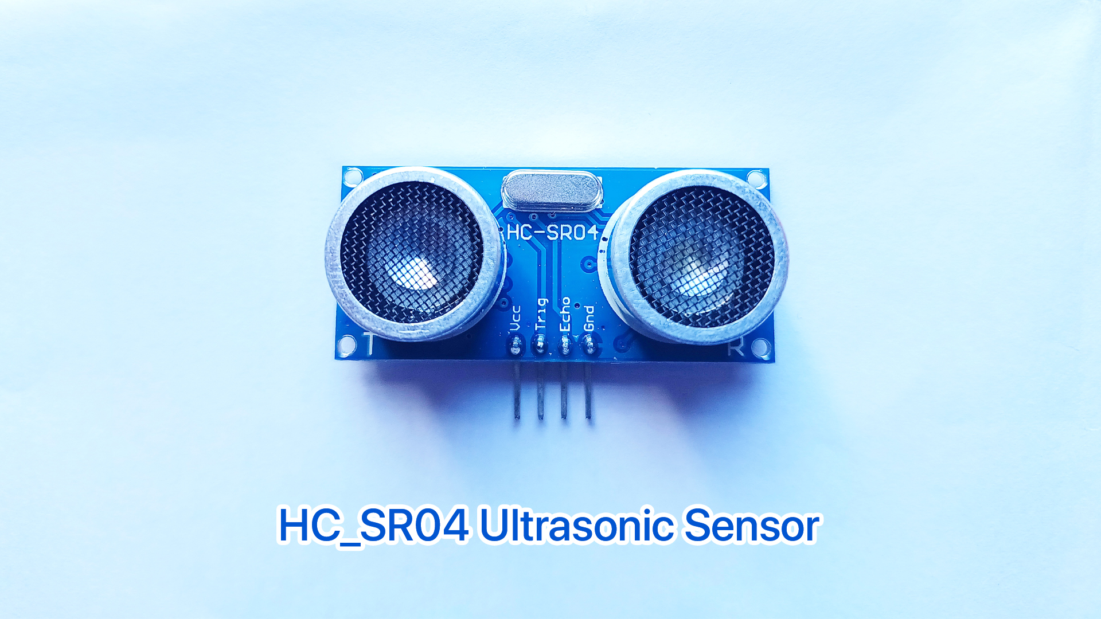
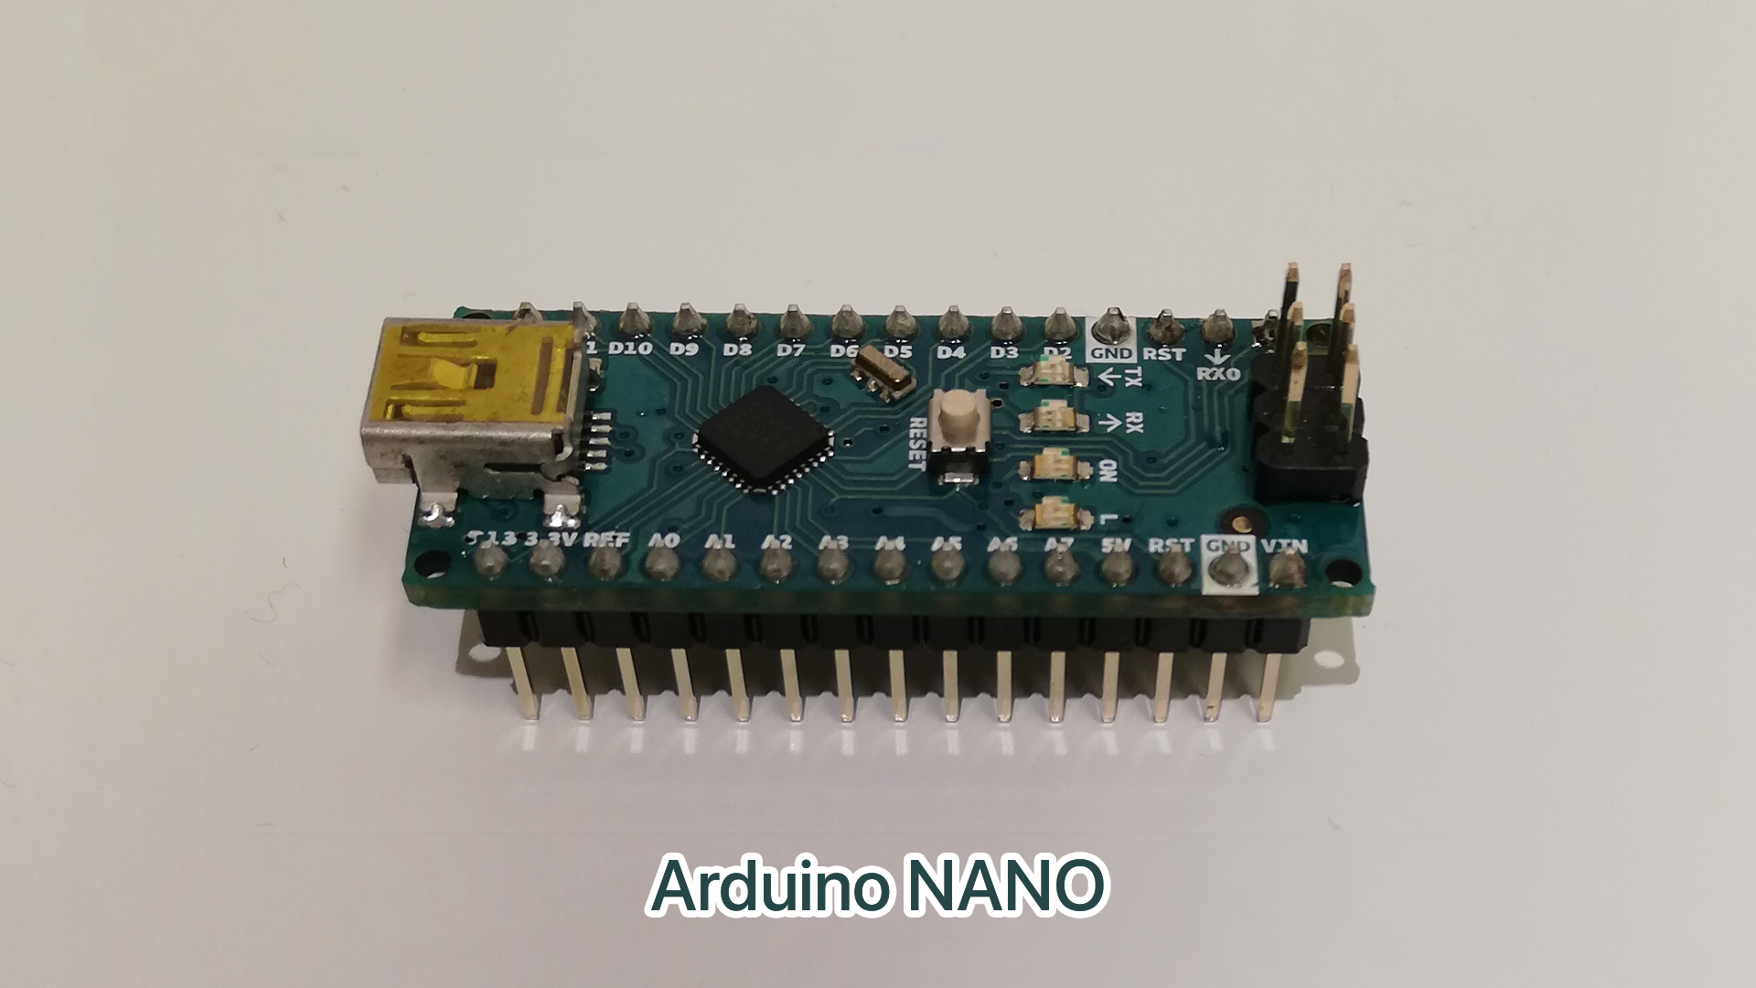
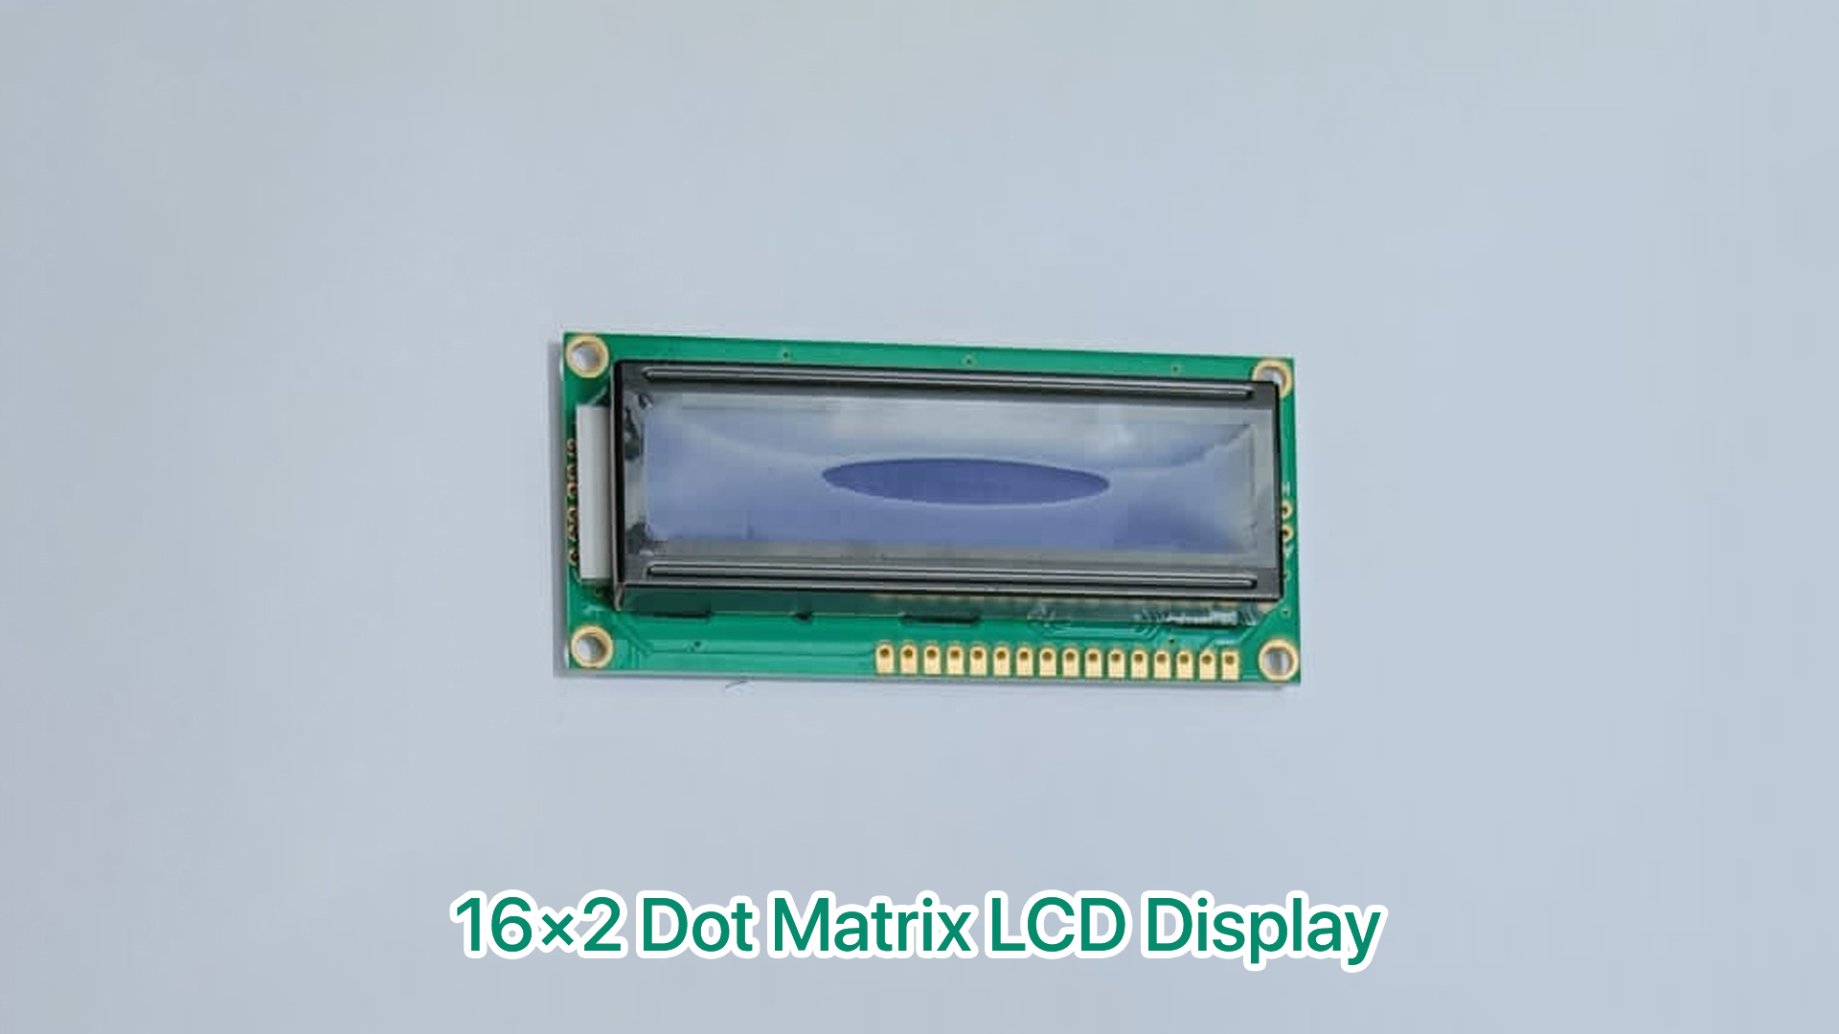
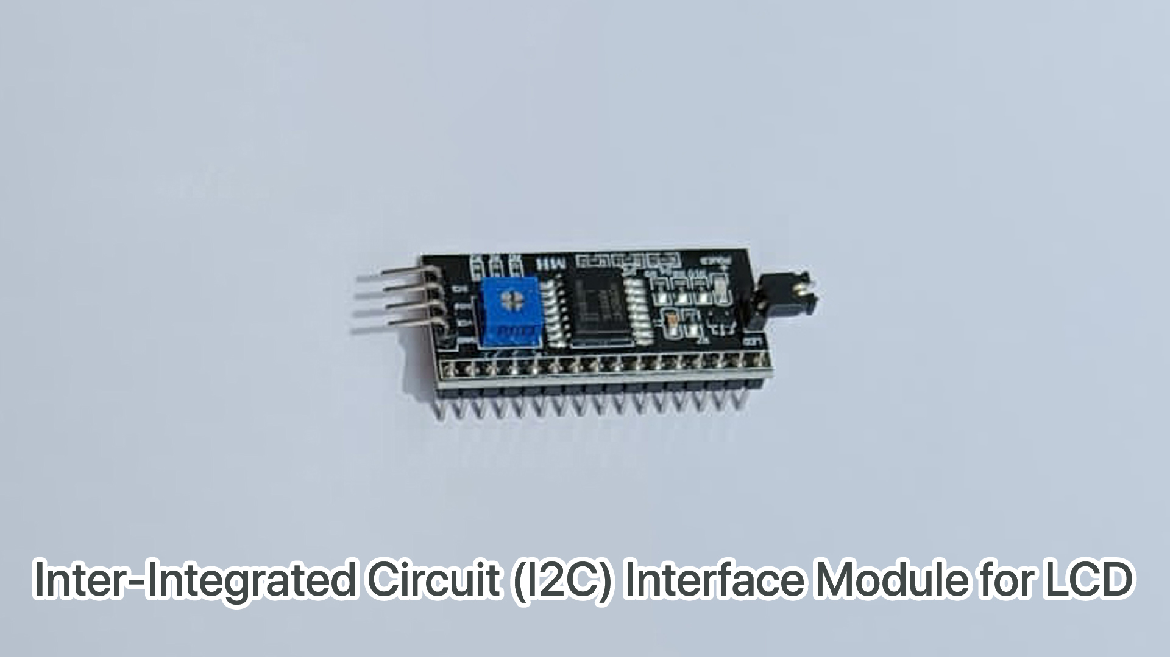
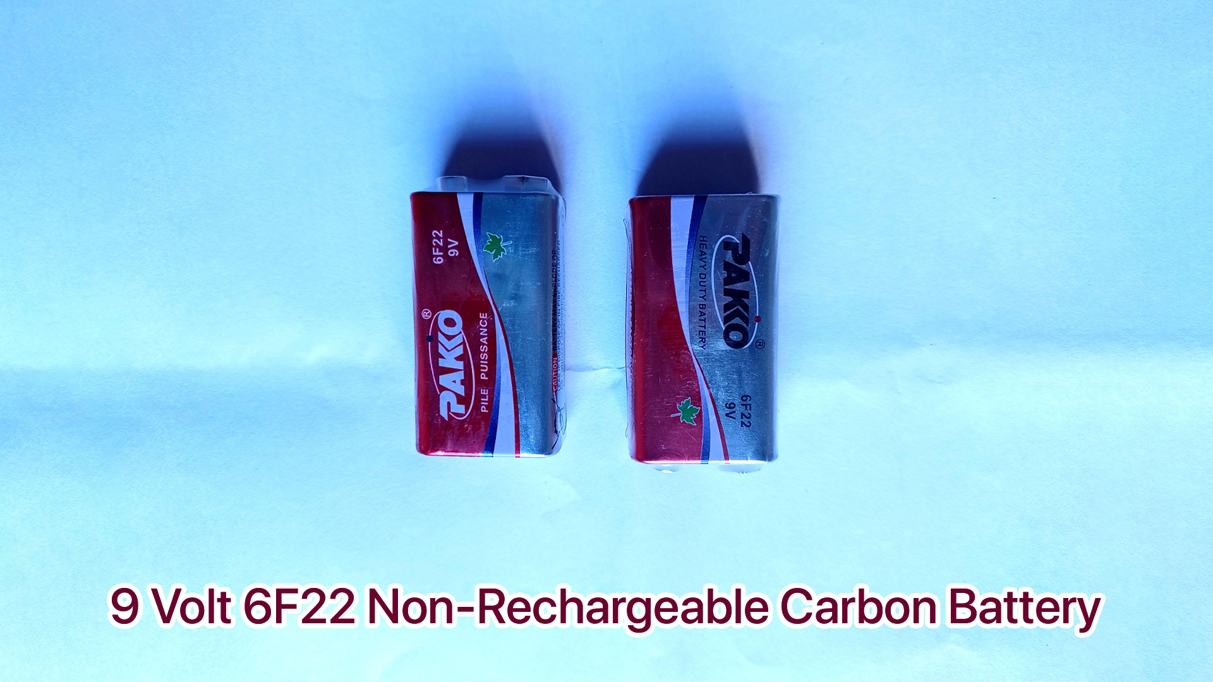
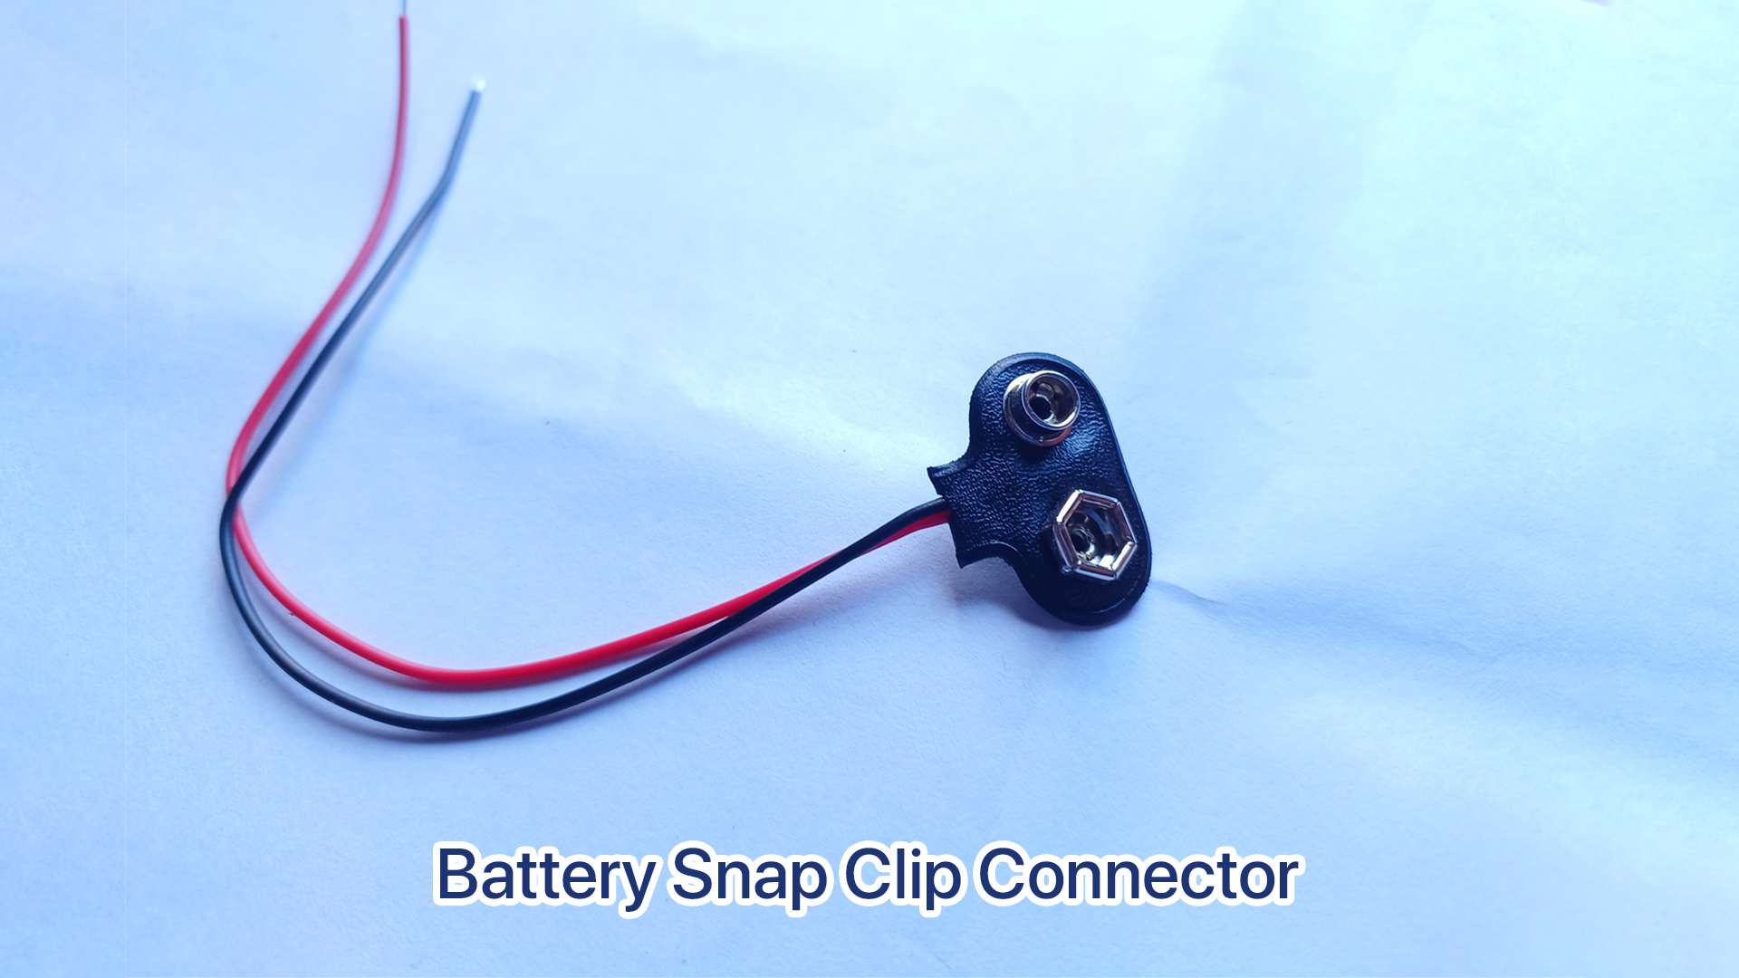
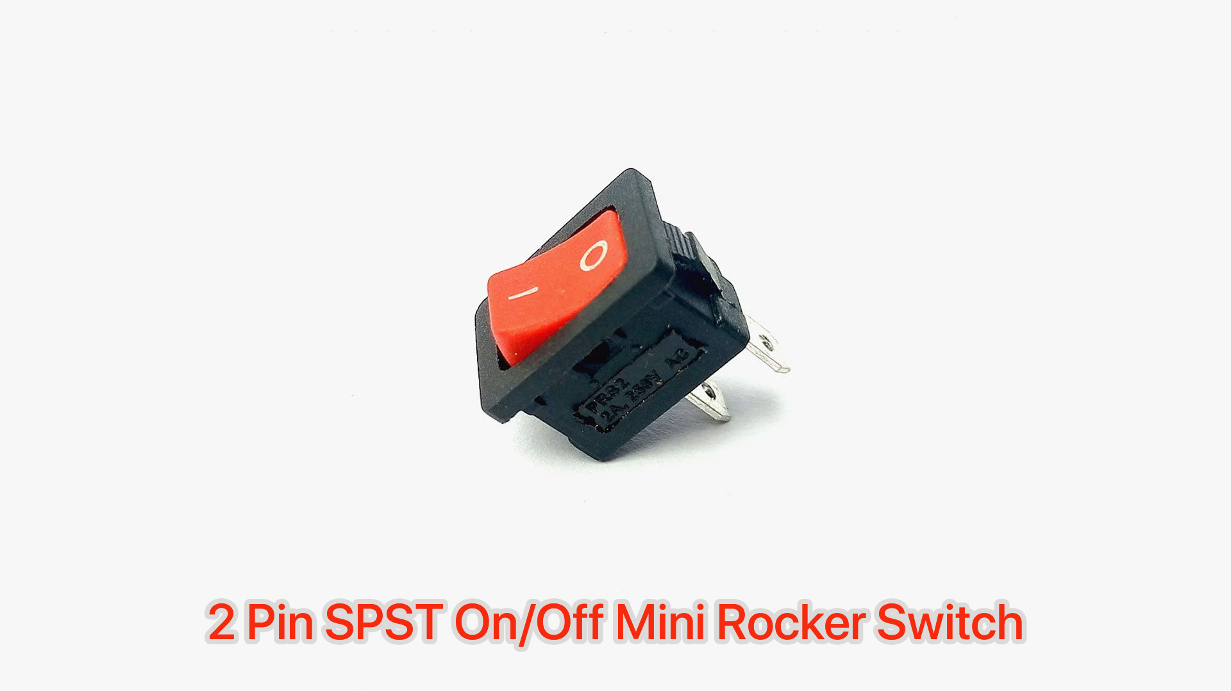
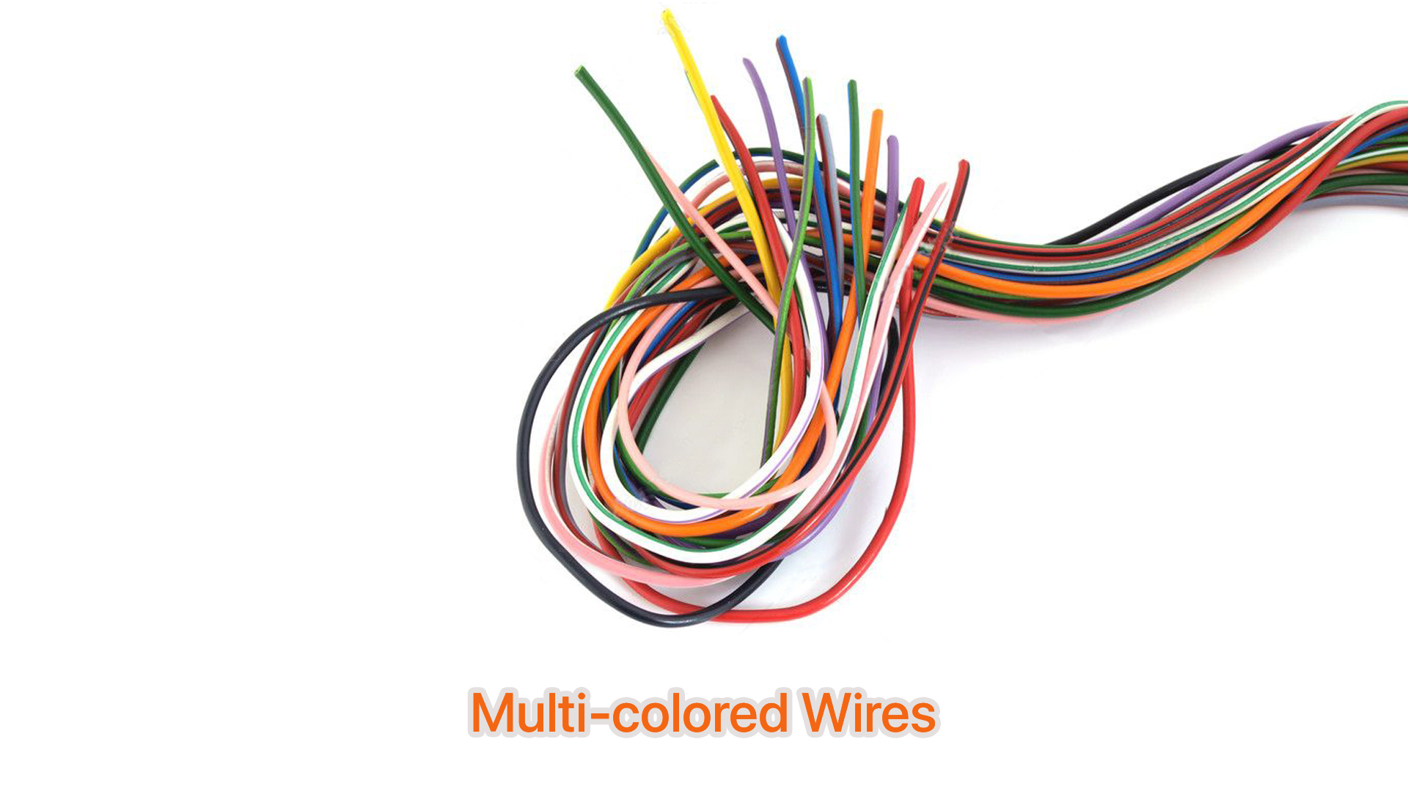
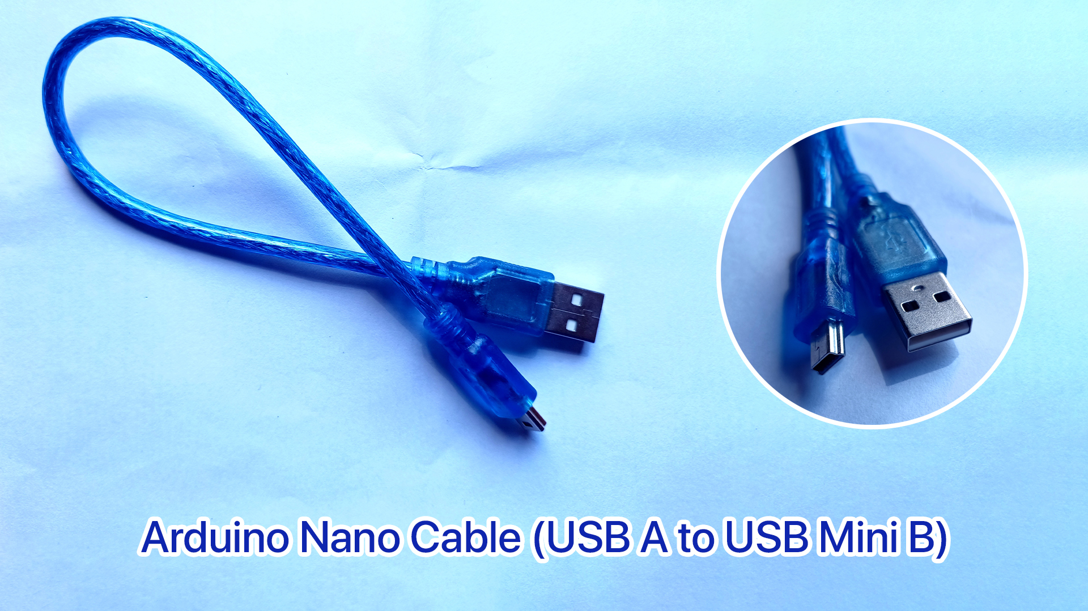
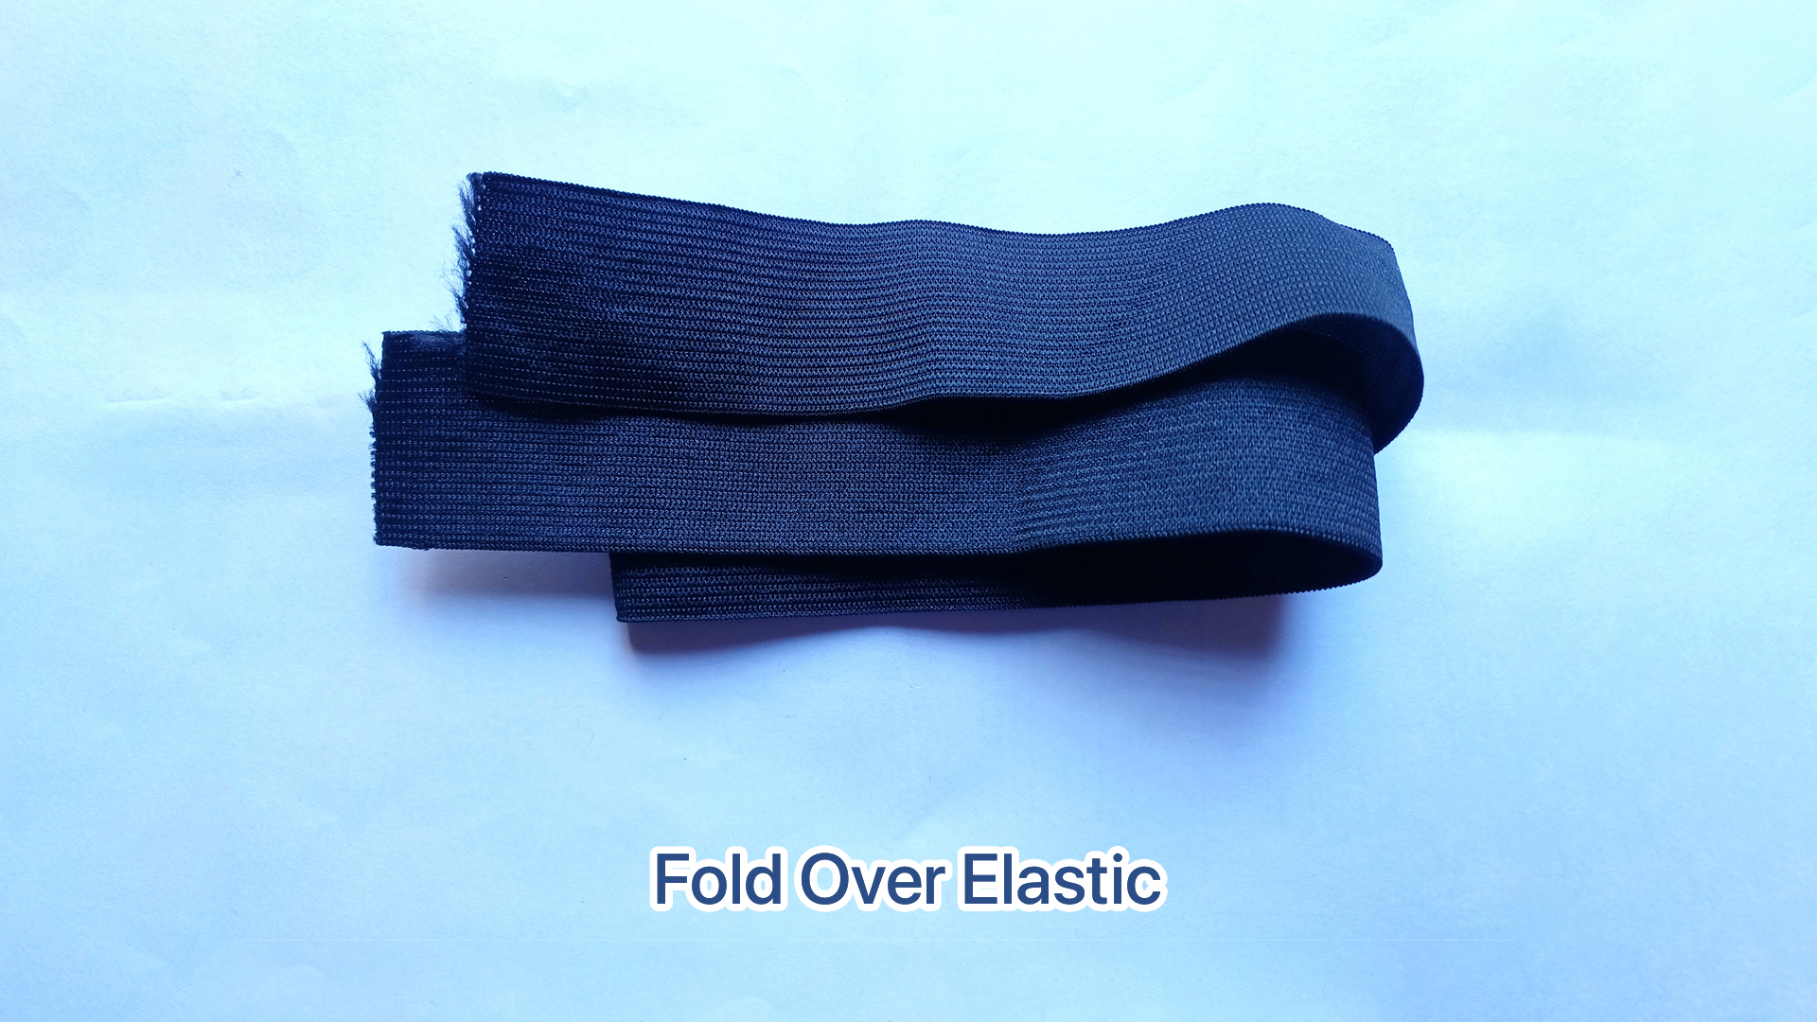
Tools and Devices

Slide 7
Methodology
Component Collection: Gathering Arduino Nano, Ultrasonic Sensor HC-SR04, 16x2 LCD Display, I2C Interface Module, 9V Battery, Mini Rocker Switch, and Connecting Wires.
Circuit Setup: Connecting components as per the circuit diagram, linking Ultrasonic Sensor, LCD Display, I2C Interface Module, and Arduino Nano.
Arduino Programming: Writing code in Arduino IDE to interact with the sensor and display, measuring and display results.
Integration: Assembling components into a compact, wearable device, ensuring portability and user-friendliness.
Testing: Thoroughly testing fully assembled device to confirm functionality, accuracy, and durability.

Slide 8
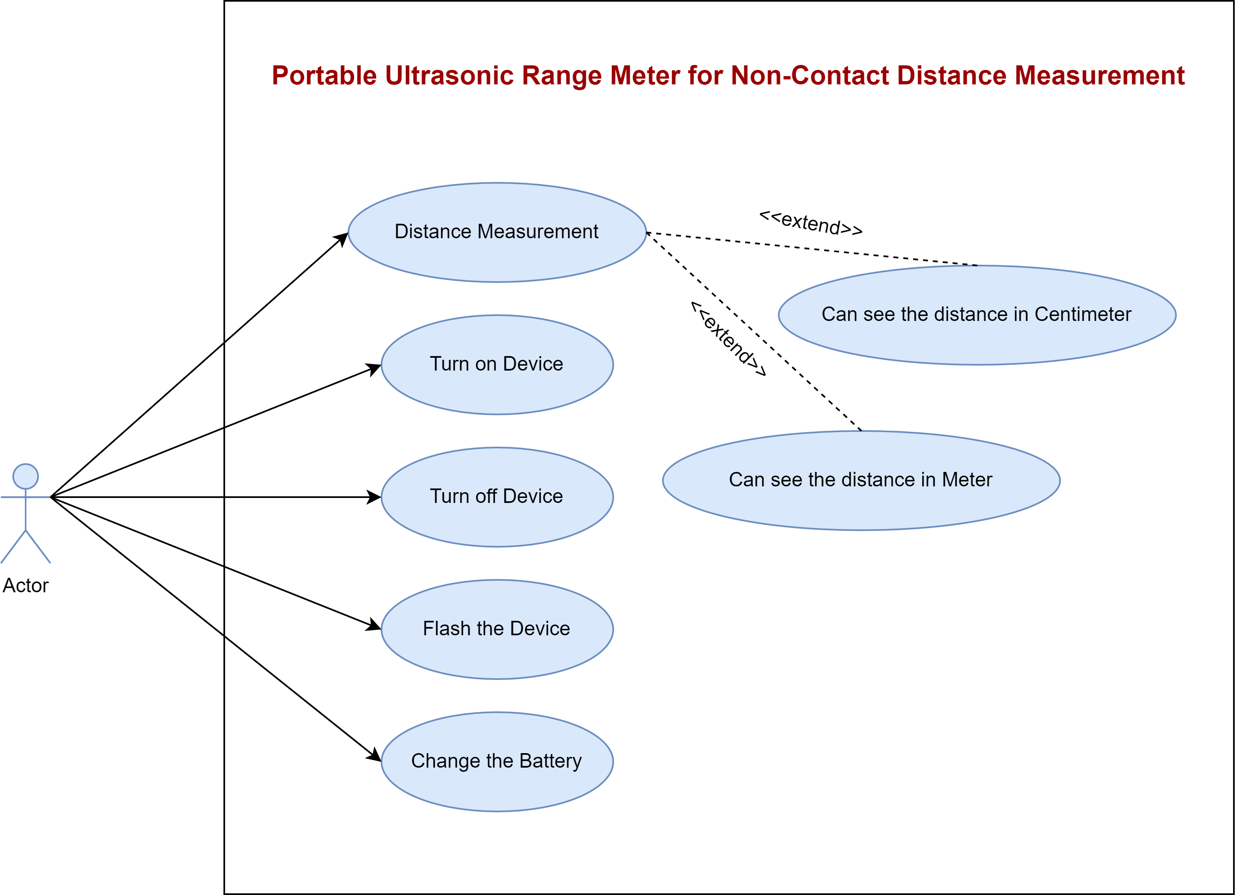
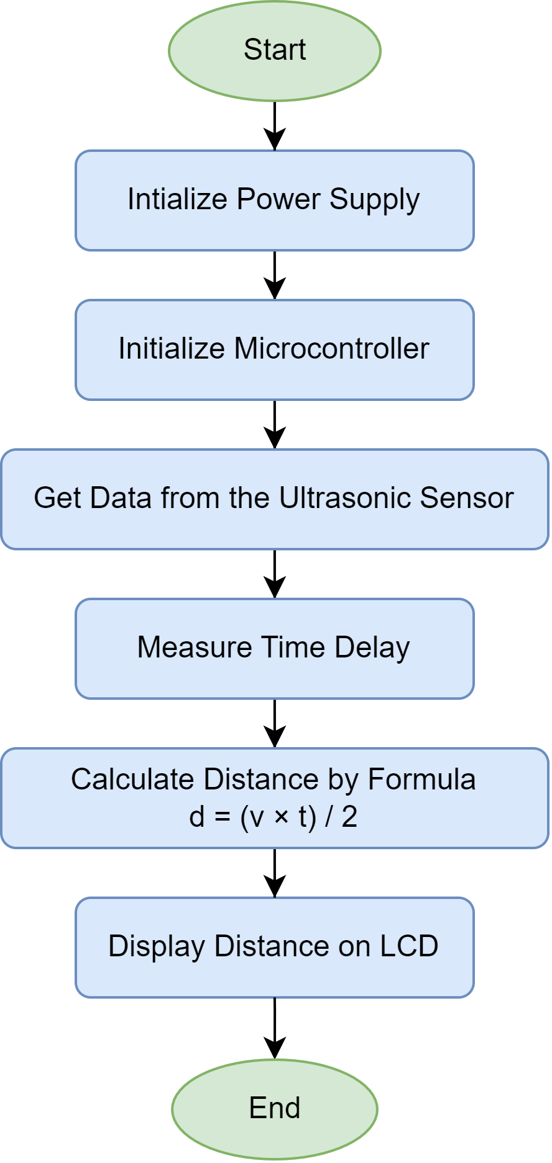
Workflow and Use-Case Diagram

Slide 9

Project Demonstration
Click here
to watch the video

Slide 10
Error Measurement and Device Accuracy
Observation | Actual Distance (cm) | Minimum Distance (cm) (from Device) | Maximum Distance (cm) (from Device) | Average Distance (cm) (from Device) | Error = |(Average Distance - Actual Distance)| / Actual Distance | Maximum Error (%) | Accuracy (%)
1 | 14.80 | 14.88 | 15.31 | 15.10 | 0.01993 | 1.99 | 98.01
2 | 21.70 | 21.29 | 22.18 | 21.74 | 0.00161 | 0.16 | 99.84
3 | 9.20 | 9.27 | 10.64 | 9.96 | 0.08206 | 8.21 | 91.79
4 | 24.50 | 25.07 | 26.32 | 25.70 | 0.04877 | 4.87 | 95.13
5 | 18.00 | 17.92 | 18.16 | 18.02 | 0.00111 | 0.11 | 99.89

Slide 11
References
“Ultrasonic Sensor-based Distance Measurement” -Arduino Project Hub
“HC-SR04 Ultrasonic Sensor User Guide” – Electro Schematics
“Arduino Official Website” – Arduino

Slide 12
THANK YOU

